Slide 1



#TaxedOut
Scan here for our campaign
The 2024 Budget was a hammer blow to hospitality. Since the Budget, there has been 84,000 job losses in hospitality. Compared to the same period over the past decade, hospitality has, on average, created 26,000 jobs each year.
The country needs jobs. We create them. But we are being #TaxedOut
The burden on hospitality is unfair. Even before the Budget, the sector paid twice as much tax as financial services as a proportion of pre-tax profits.
The UKHospitality Social Productivity Index shows that hospitality is the highest performing socially productive sector, creating jobs and routes into training and careers which are available to everyone, everywhere from our cities, to our towns and coastal and rural communities. It creates places where people want to live, work and invest.
In this year’s Budget we need a fundamental change of approach from Government. We are calling for three immediate changes that can be made to take the brakes off our sector so that we can create places where people want to live, work and invest.
Lower business rates to revive high streets.
Our high streets are a vital social and economic resource, but running businesses in the middle of our communities is being punished by the tax system.
The Government should follow the announcement in last year’s Budget of Business rates reform with a maximum discount for hospitality businesses under £500,000 rateable value, while exempting larger hospitality properties from the business rates surcharge.
Fix NICs to boost jobs
The NICs changes in the Budget have led to 84,000 hospitality job losses already. We are calling for the extension of the current exemptions to include young people and people returning to work from welfare.
Cut VAT on hospitality to drive investment
While other countries have supported hospitality with a lower rate of VAT, hospitality in the UK pays the full 20% - putting our tourism industry at a disadvantage and making it harder for people to support their local businesses.

Slide 2

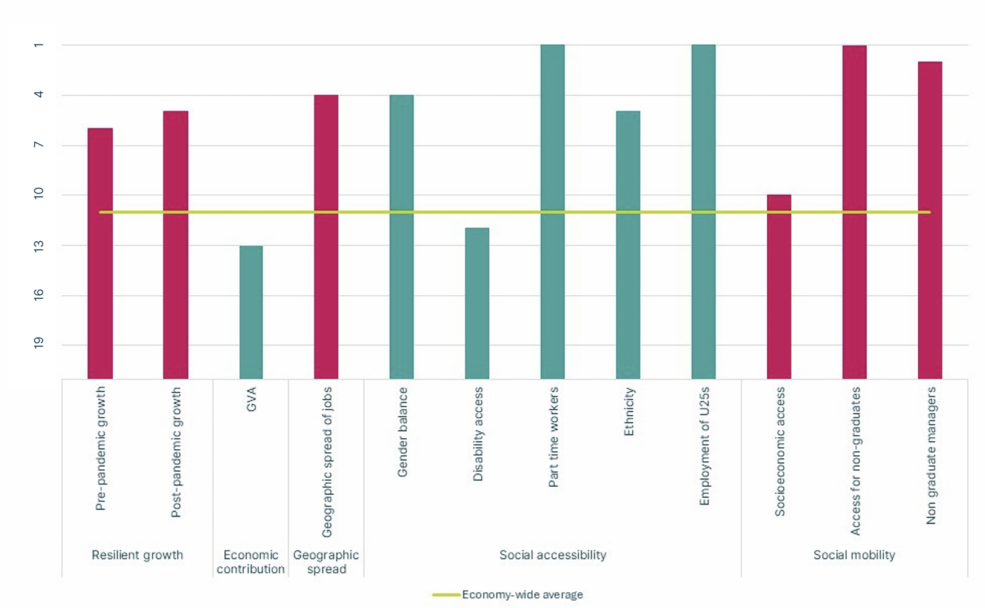
Hospitality has the highest social productivity
Scan here for our Social Productivity Index
The UKHospitality Social Productivity Index shows how 21 industrial sectors perform on a range of measures which together capture the socially and geographically accessible the growth they create
Hospitality has the highest average performance across the characteristics we use to calculate social productivity. It is the number one provider of employment to under 25s, part time workers, and to non-graduates.
Economic impact – hospitality grew at above the economic average for the ten years before and four years after the pandemic, highlighting its status as a resilient and fast-growing sector. The hospitality sector continues to be in the top half of sectors for economic growth. Today, it is the 13th largest sector in the UK economy by GVA, larger than automotive, pharmaceuticals and aerospace combined.
Geographic impact - hospitality is present across the UK as one of the top quarter of most geographically dispersed sectors, creating jobs and growth in each region.
Social impact – hospitality performs exceptionally well as an accessible and socially mobile employer, offering economy-leading routes into work and leadership roles It is also particularly important as an employer of people whose parents worked in non-professional or managerial roles, or who themselves are not graduates. That commitment to social mobility continues after hire, with only two sectors having a higher percentage of managers without degrees.
ukhospitality.org.uk THE VOICE OF HOSPITALITY

